Slide 1


The Effect of Climate Change and Regulations on Fishers Portfolios:
Substitution between Coastal Pelagic Species
Felipe J. Quezada
UC Santa Cruz
NOAA Southwest Fisheries Science Center
November 3rd, 2021

Slide 2
CAFA Project
NOAA’s Climate and Fisheries Adaptation (CAFA) program:
Supports targeted research to promote sustainable management, adaptation and resilience of the nation’s valuable fish stocks and fisheries-dependent communities in a changing climate
More information here

Slide 3

California Current System (CCS)
Unique ecosystem
Provides many ecosystem services
Home to many protected species
Sustains commercial and recreational fisheries:
Forage species
Coastal Pelagic Species
Illustration by Fiona Morris
Notes:
Coastal Pelagic Species refers to the group of species included in the Pacific Fishery Management Council’s
Coastal Pelagic Species Management Plan (https://www.fisheries.noaa.gov/management-plan/coastal-pelagic-species-management-plan)

Slide 4
Coastal Pelagic Species in CCS
Pacific sardine:
Market squid:
Northern anchovy:
CPS SAFE: “In 2012, PSDN fishers shifted to squid during the summer due to low abundance”
Closure in 2015.
Limited Entry since 2002
Affected negatively by ENSO in 2015.
High prices and landings
Highly variable biomass driven by oceanographic conditions
Affected by oceanographic variability
Reduction quota in place
Low prices and landings
Record high abundance since 2017
Partial substitute for sardine when its collapsed
Important bait species for recreational fisheries
Likely to be substitute of Pacific sardine.
Notes:
1- Warm ocean cycle favors sardine and reduce anchovy, though there are exceptions, such as during the recent ‘warm blob’ heatwave.
2 – Squid may actually be a better substitute in terms of the fleet.
- Include fisheries background??? (trip scenario)

Slide 5
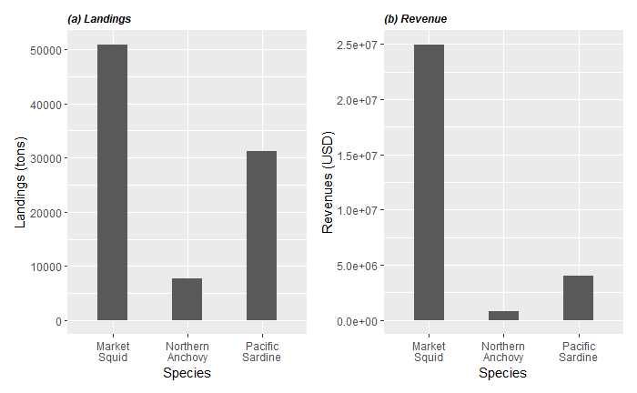
Coastal Pelagic Species in CCS
Period: 1980-2020
Notes:
SEINE is the main Gear used by this fleet.

Slide 6
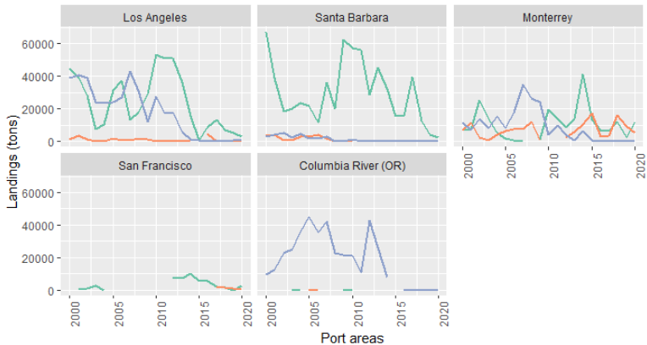
Trends in CPS fishery
(a) Landings
Species abundance?
Market conditions?
Notes:
WHAT IS BEHIND THIS TRENDS?
- Can they process in the same port?
- Vessel specialization. Can they switch between species or ports? (I can answer this with the new data)

Slide 7
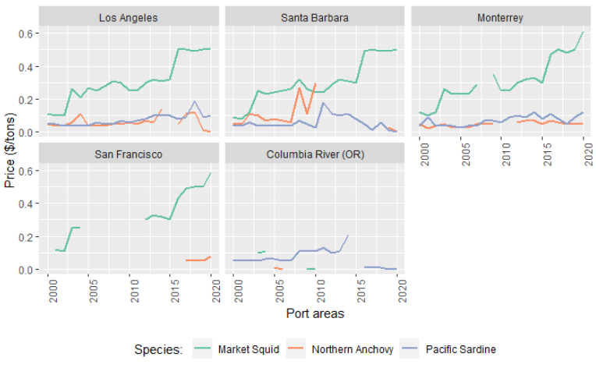
Trends in CPS fishery
(b) Prices
High prices for squid
Notes:
WHAT IS BEHIND THIS TRENDS?
- Can they process in the same port?
- Vessel specialization. Can they switch between species or ports? (I can answer this with the new data)

Slide 8
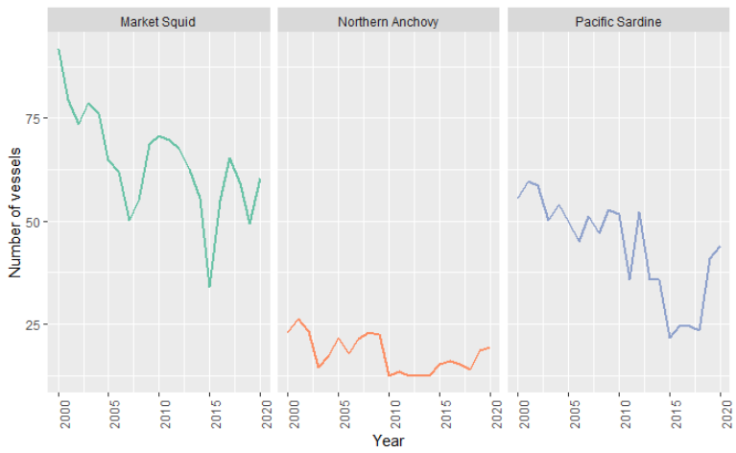
Trends in CPS fishery
(c) Number of vessels
But, decrease of number of vessels for market squid
Notes:
WHAT IS BEHIND THIS TRENDS?
- Can they process in the same port?
- Vessel specialization. Can they switch between species or ports? (I can answer this with the new data)

Slide 9
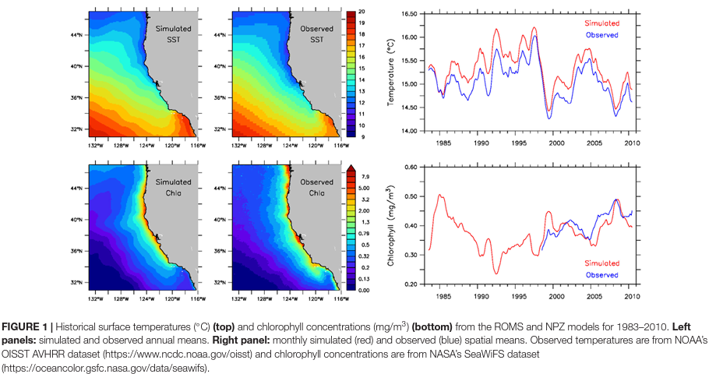
Climate Change
Climate is changing!
Source: Fietcher, et al. (2021)

Slide 10
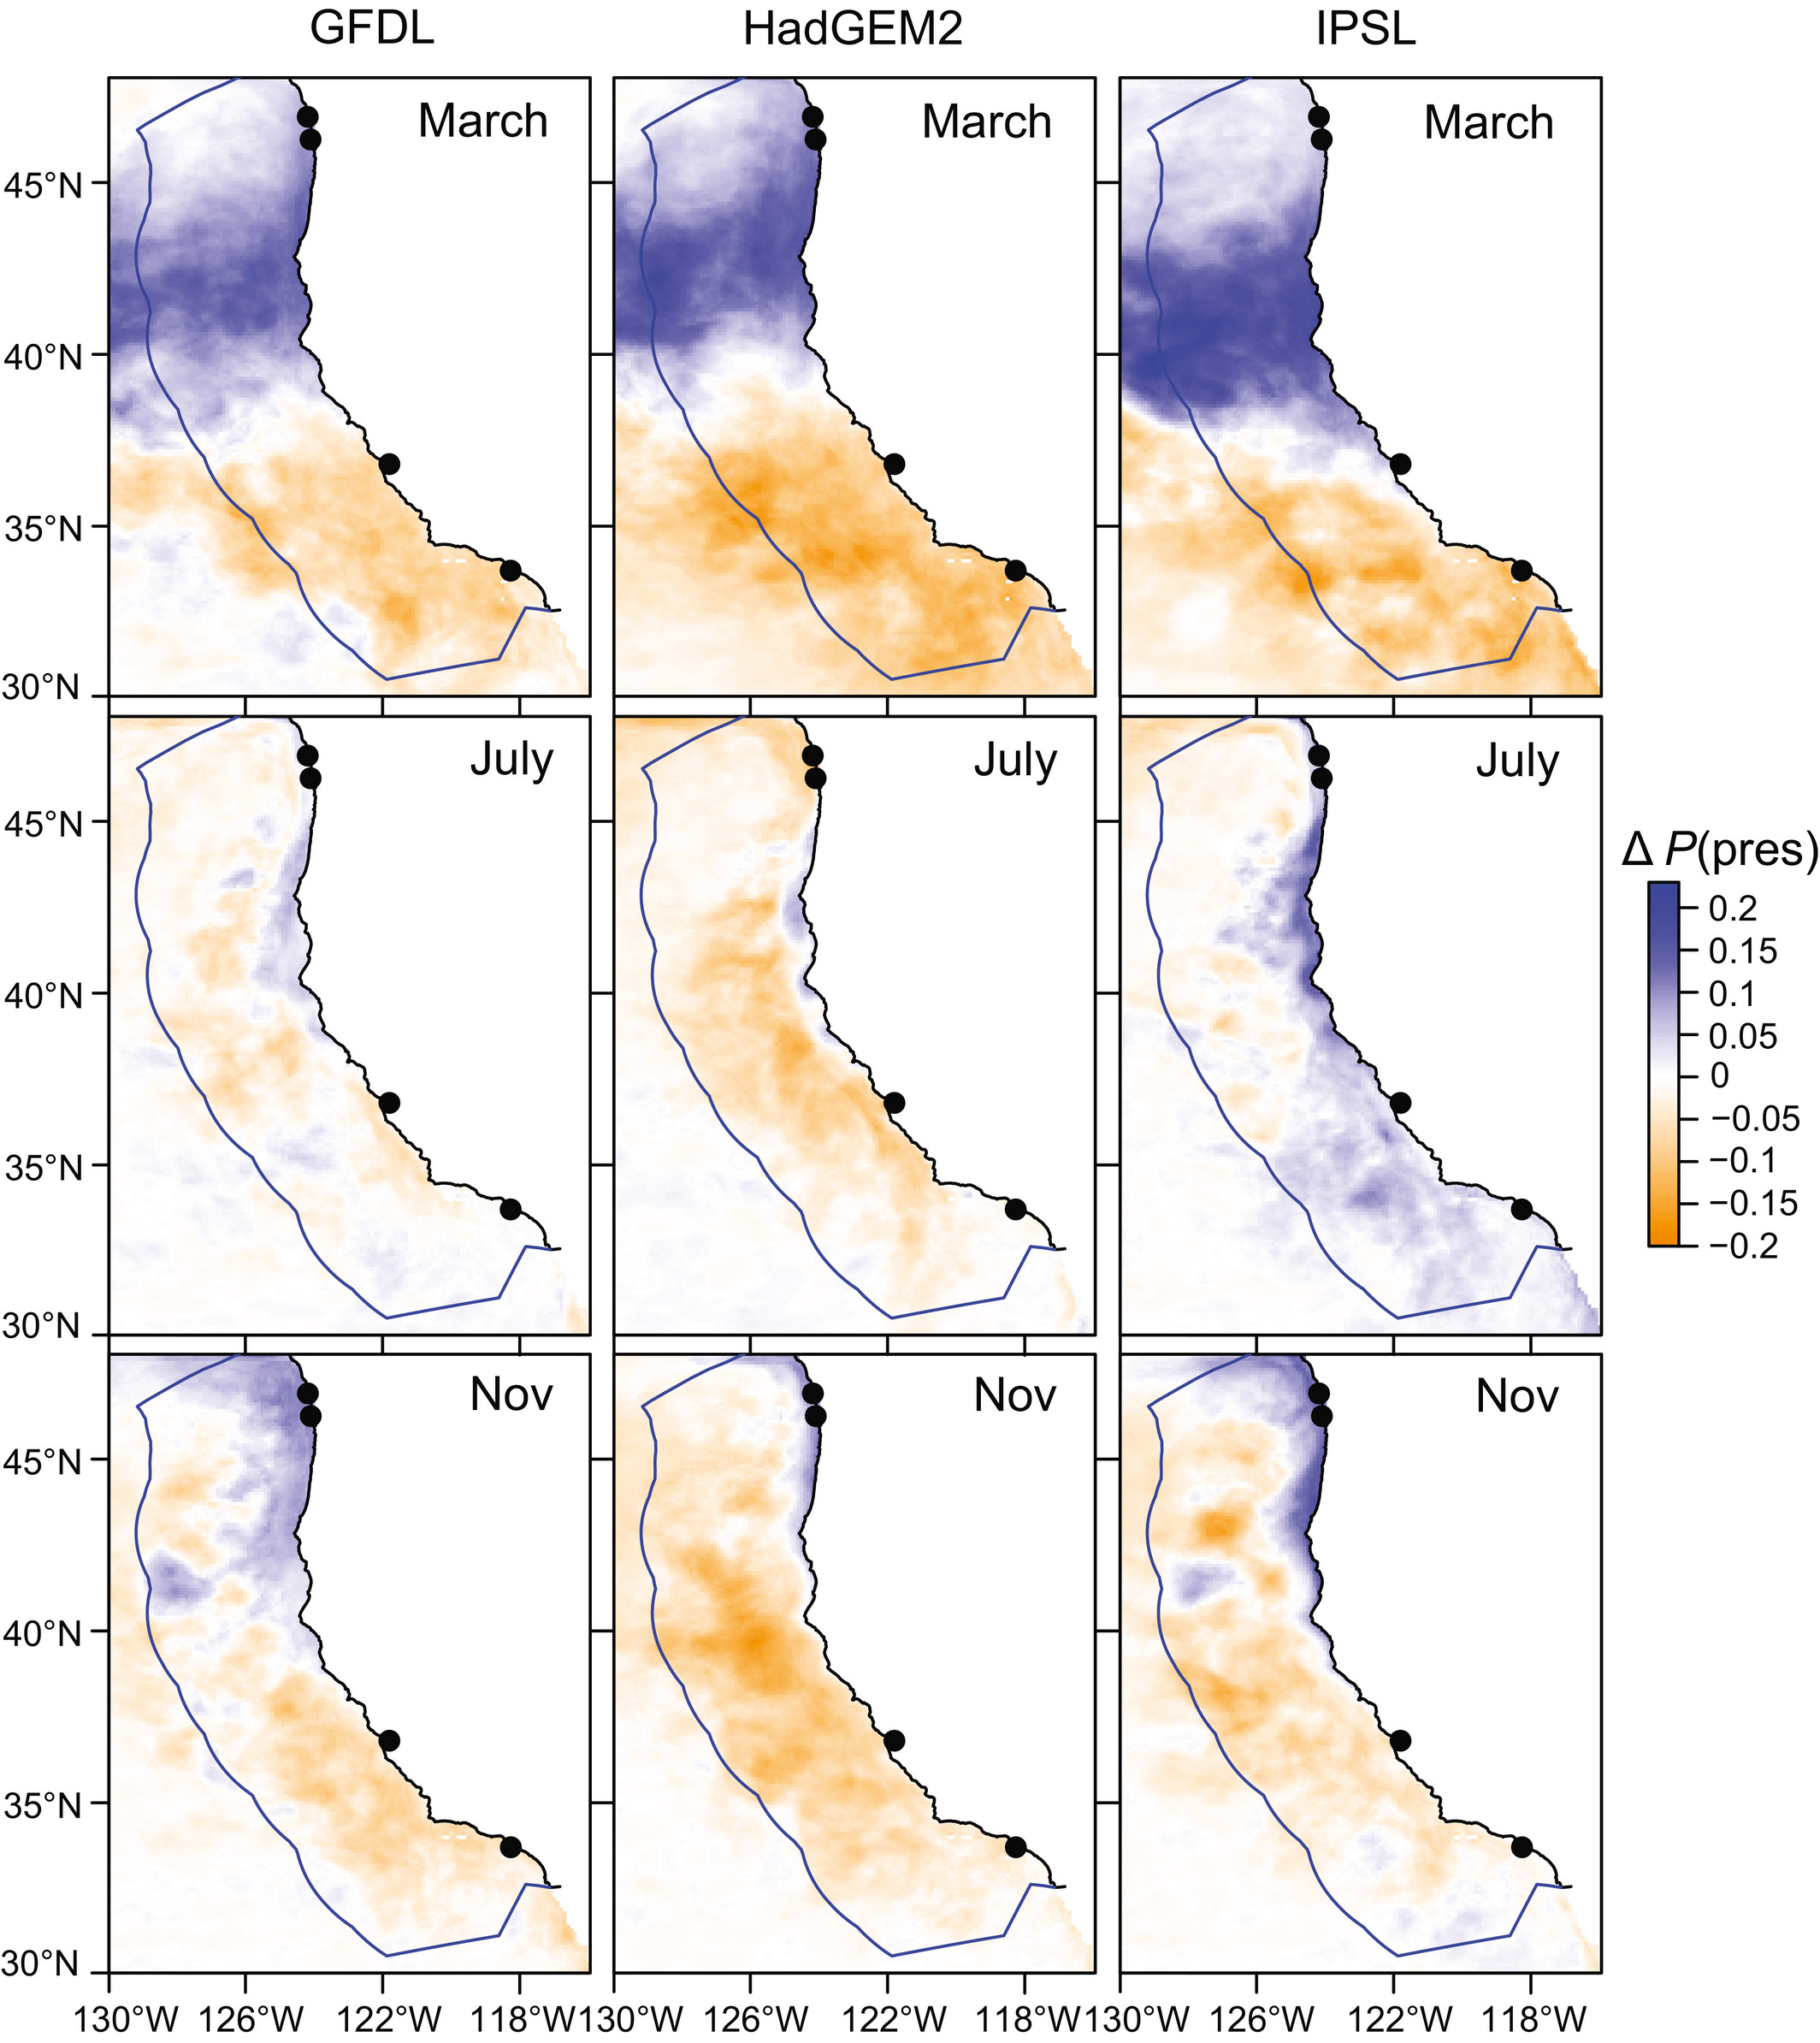
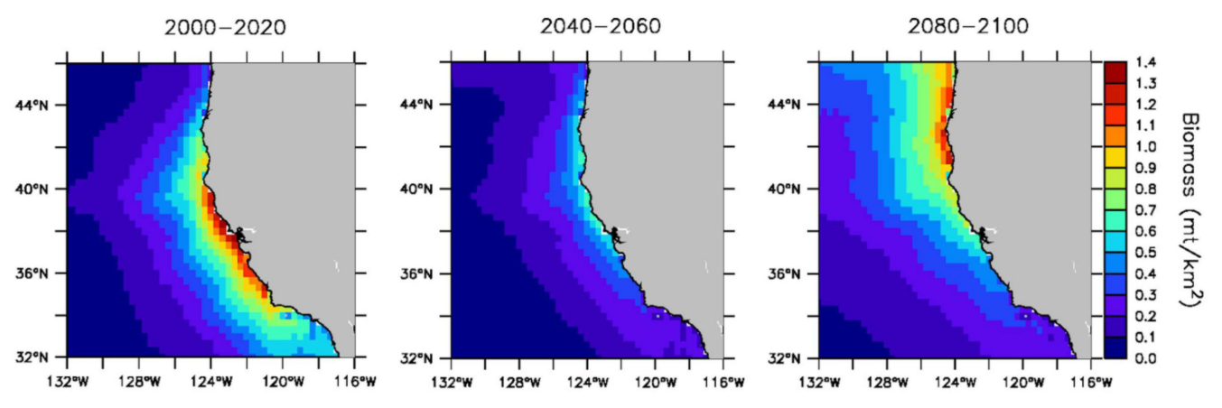
Effect on species distributions
For instance, projected changes in Pacific sardine distribution
Source: Fietcher, et al. (2021)
Figure. Mean change in projected sardine habitat suitability (2040–55 period minus 2000–2015 period), in the three ESMs. Source: Smith et al. (2020)

Slide 11
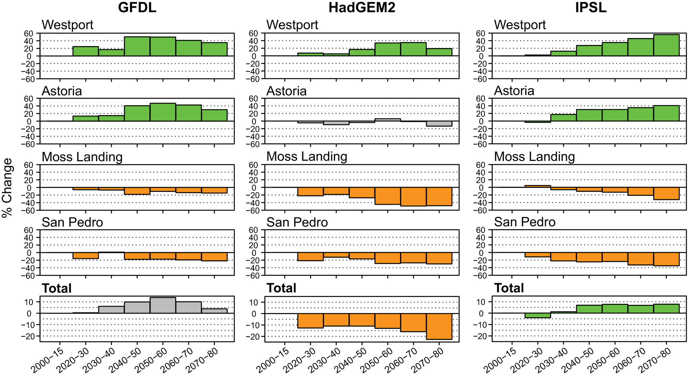
Effect on landings
Source: Smith et al. (2020)
Smith et al. (2020) found a positive effect of species distribution on Pacific sardine landings.
Changings on distribution could also trigger changes in regulation (e.g. closures)

Slide 12
Research Question
How will climate change impact fishing communities?
Specific questions:
How do changes in species distribution and regulations (i.e. closures) affect landings and vessel participation in the multispecies Coastal Pelagic Species (CPS) fishery?
Contribution:
Previous work has focused on one species
Important to study other species and their interactions in fishers’ portfolio to assess climate impacts on CPS fleet.
Presence of other species might impact targeting decisions.

Slide 13
Methodology
Two approaches
Landings model (results using public aggregate data).
Participation model (no results yet).
Data
Fish tickets from The Pacific Fisheries Information Network (PacFIN) from 1980-2020
Fishing locations from logbooks
2000-2020, but depend on species
Maybe I can use Global Fishing Watch (2012-2020)
Current and projected species distribution from Species Distribution Models (SDMs) from 1997-2018
Notes:
The SDM figures are quite important and maybe novel to the audience, so perhaps give them their own slide and take time on them.

Slide 14
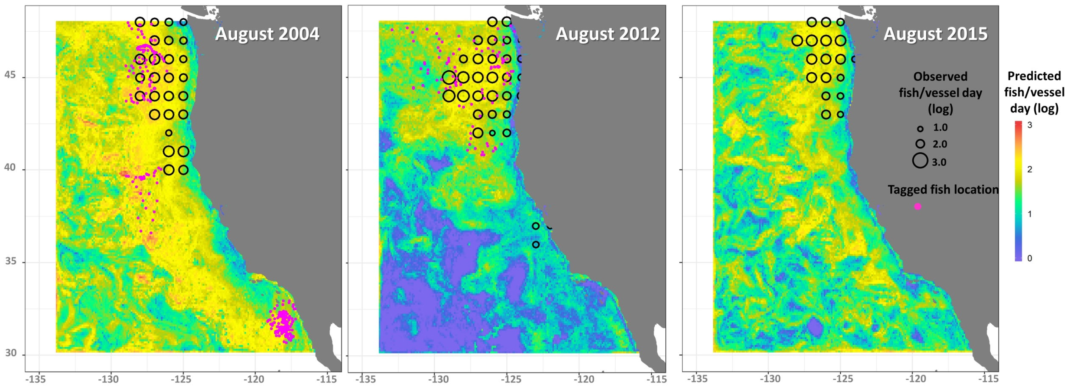
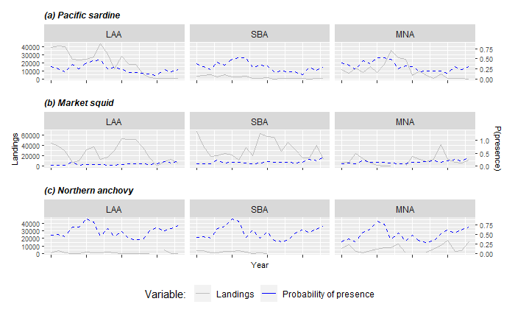
SDMs and Landings
SDMs to model distribution of sardine, anchovy, market squid, herring (Muhling et al. 2019, 2020, Brodie et al. 2021)

Slide 15
Landing model
Hierarchical Bayesian Hurdle model
All parameters are random variables (uncertainty)
Multilevel effects (i.e. hierarchical effects by ports/vessel)
Incorporate previous knowledge
Hurdle allows to model the zeros.
Separate model by species
Ports were chosen using historical landings.
SDMs outputs: Projection and interactions.
Important to include dynamic SDMs of all species
Smith et al. (2020) did not project future changes in squid/anchovy abundance.
Notes:
I would put this plot from James’ paper between slides 8 and 9 (and perhaps replace slide 8 with this). With his plot you show how sardine probability of presence will change and then you could also show Fig. 7 from James in another slide to show how these changes in sardine distribution affected landings. Then on slide 9 one can see how your work builds on James’ – important to stress that previous work has focused on one species but that there is a need to look at other species in portfolio to assess climate impacts on CPS fleet. Also presence of other species might impact targeting decisions and so important to include dynamic SDMs of all species (James did not project future changes in squid/anchovy abundance or SDMs)
- port v/s species

Slide 16
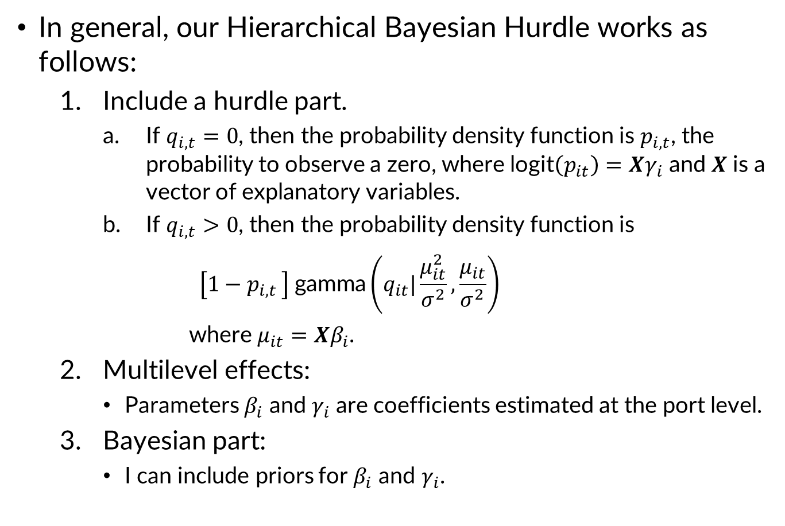
Methodology
In general, our Hierarchical Bayesian Hurdle works as follows:
Include a hurdle part.
If $q_{i,t}=0$, then the probability density function is $p_{i,t}$, the probability to observe a zero, where $\text{logit}\left(p_{it}\right)=Xγ_{i}$ and 𝑿 is a vector of explanatory variables.
If $q_{i,t}>0$, then the probability density function is
$$\left[1−p_{i,t }\right] \text{gamma}\left(q_{it}|\frac{μ_{it}^{2}}{σ^{2}},\frac{μ_{it}}{σ^{2}}\right)$$
where $μ_{it}=Xβ_{i}$.
Multilevel effects:
Parameters $β_{i}$ and $γ_{i}$ are coefficients estimated at the port level.
Bayesian part:
I can include priors for $β_{i}$ and $γ_{i}$.
Notes:
$q_{i,t}$ is the observed landings of the corresponding species landings,

Slide 17
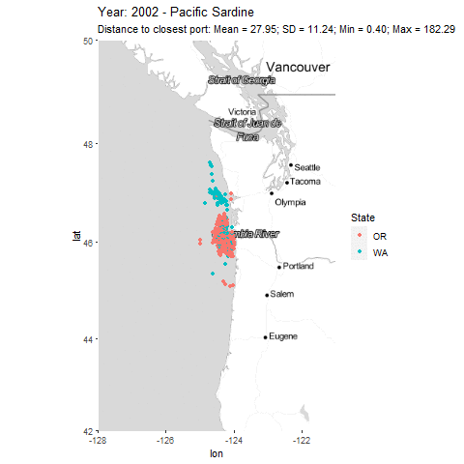
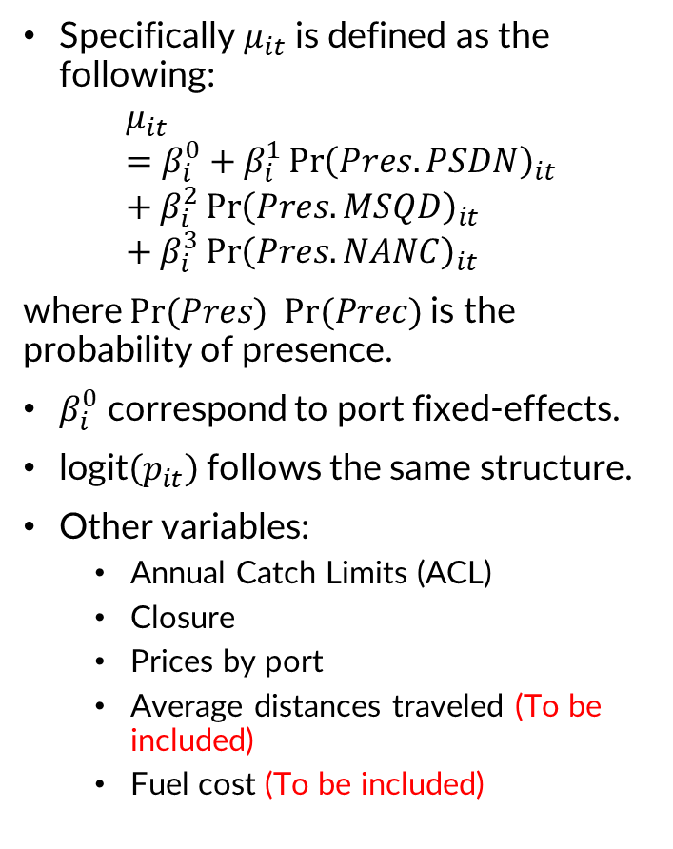
Methodology
Specifically $μ_{it}$ is defined as the following:
$$μ_{it}=β_{i}^{0}+β_{i}^{1}{\operatorname{Pr}\left(Pres.PSDN\right)}_{it}+β_{i}^{2}{\operatorname{Pr}\left(Pres.MSQD\right)}_{it}+β_{i}^{3}{\operatorname{Pr}\left(Pres.NANC\right)}_{it}$$
where $Pr(Pres)$ $Pr(Prec)$is the probability of presence.
$β_{i}^{0}$ correspond to port fixed-effects.
$\text{logit}\left(p_{it}\right)$follows the same structure.
Other variables:
Annual Catch Limits (ACL)
Closure
Prices by port
Average distances traveled (To be included)
Fuel cost (To be included)
Notes:
Talk about the construction of probability of presence
Important to highlight here that the fishery operates close to shore mostly undergoing daily trips

Slide 18
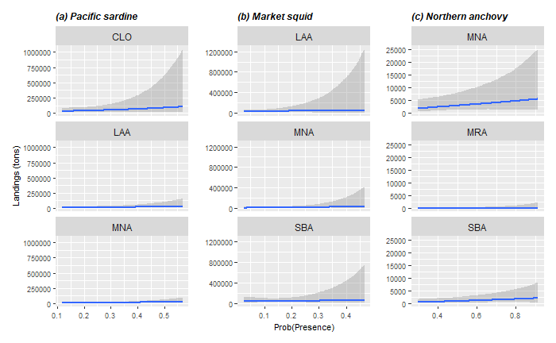
Results: Landings positively related to probability of presence
Notes:
Stretch figure larger, give main message in title “Landings positiviely related to probability of presence”, or something like that…

Slide 19
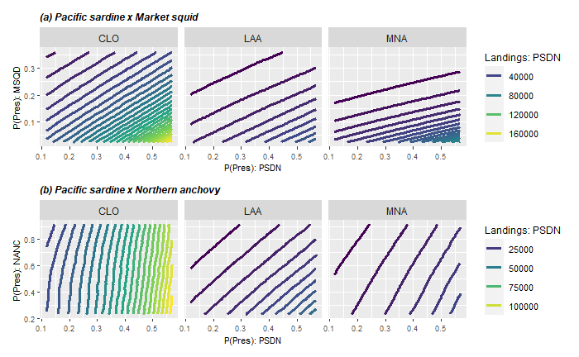
Results: Squid is a substitute of sardine
Notes:
Take your time in describing these complex plots.
Change from acroynms to words or names.
Add main message in title and text boxes.

Slide 20
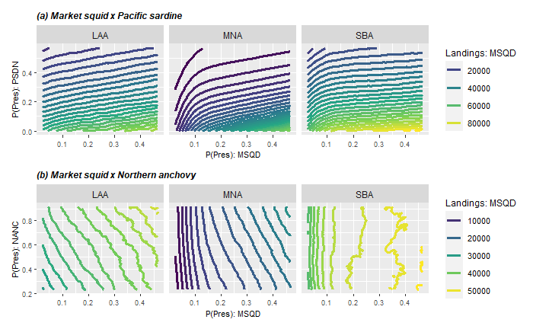
Results: Sardine more preferred than squid
Notes:
Same edits as previous similar slide

Slide 21
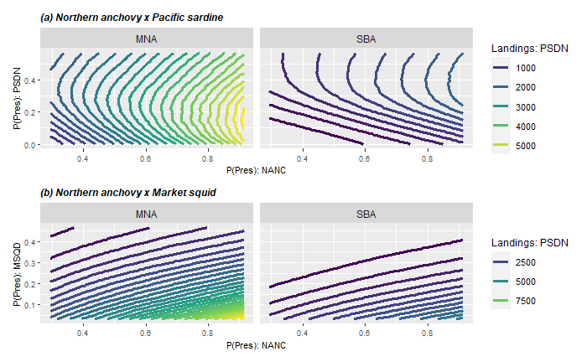
Results: Northern anchovy is less preferred than sardine and squid
NANC
NANC
Notes:
Same edits as previous similar slide

Slide 22
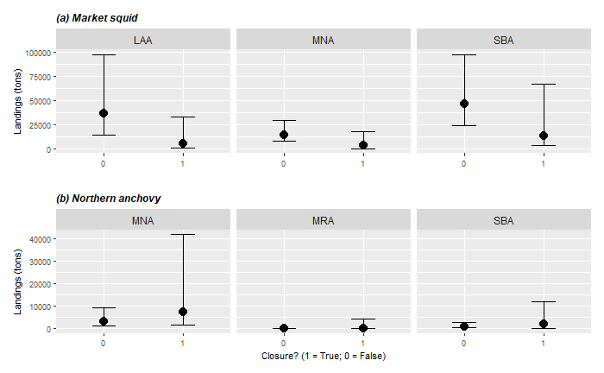
Results: Sardine closure reduce squid landings
Notes:
Verbally talk about confounding of environment similarly affecting squid and sardine dynamics sardine was closed in 2015 and 2015 was also a low year in terms of squid during ENSO.
It should be solve though when we include SDM for market squid.
Replace port codes with names.

Slide 23
Conclusions
Slightly positive effect of presence on landings.
Substitution between market squid and Pacific sardine.
It seems that Pacific sardine is more preferred than market squid.
Northern anchovy is less preferred than sardine and squid when both are available.
Closure reduce market squid landings. Is this because of a lower participation in fishing?
Be cautious with port constraints.

Slide 24
Future work
Incorporate individual data for landings.
Check whether a vessel can switch between species or ports.
Vessels/port landings.
Vessel/port hierarchal effects.
Estimate a discrete choice model for participation.
Forecast landings & participation using SDM projections.
Study changes in effort? (number of trips by species)
Other project:
Decision of where and what to fish.
Forecast future fleet movements
Discrete choice model for daily species/location decision:
Daily information for landings.
Global Fishing Watch.
Notes:
also decision of where to fish and what to fish for is related to the discrete choice modelso I would put that first for context, then discrete species and location choice model and forecast future fleet movements as the third bullet. All this bullets are actually related to the same project I think so perhaps keep projects singular?

Slide 25
Thanks for your attention!
Felipe J. Quezada
Postdoctoral Scholar
UC Santa Cruz & NOAA-SWFSC
felipequezada.com
felipe.quezada@noaa.gov

Slide 26
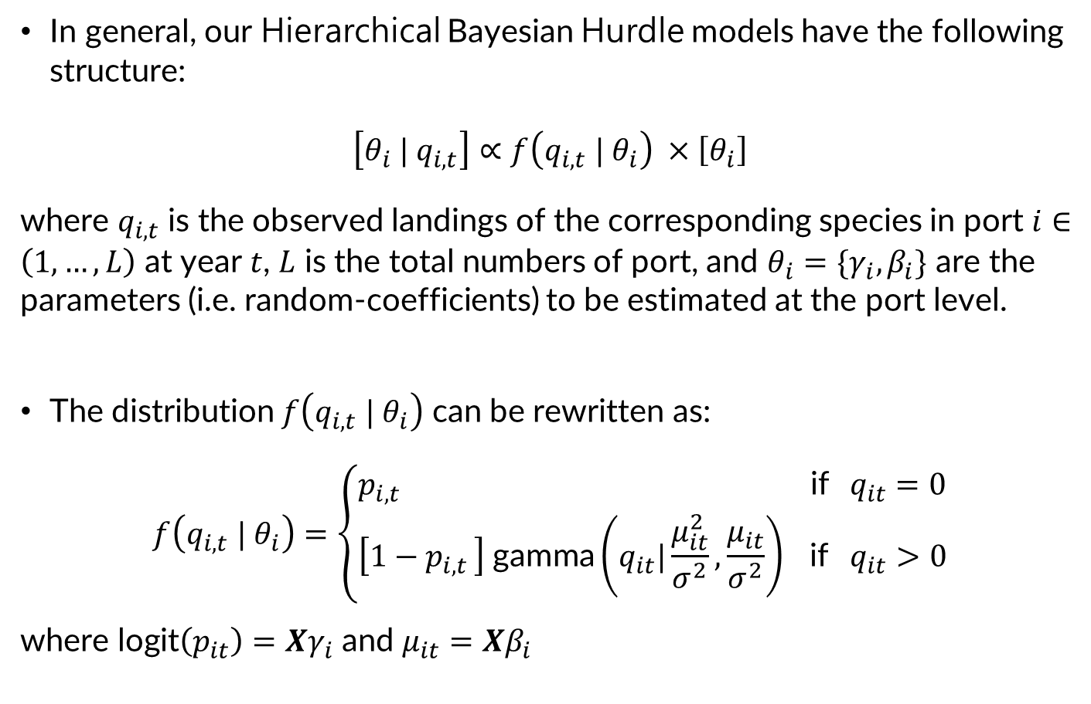
Methodology
In general, our Hierarchical Bayesian Hurdle models have the following structure:
$$\left[θ_{i} | q_{i,t}\right]∝f\left(q_{i,t} | θ_{i}\right) ×\left[θ_{i}\right]$$
where $q_{i,t}$ is the observed landings of the corresponding species in port $i∈\left(1,…,L\right)$ at year $t$, $L$ is the total numbers of port, and $θ_{i}=\{γ_{i},β_{i}\}$ are the parameters (i.e. random-coefficients) to be estimated at the port level.
The distribution $f\left(q_{i,t} | θ_{i}\right)$ can be rewritten as:
$$f\left(q_{i,t} | θ_{i}\right)=\left\{\begin{aligned}p_{i,t } \text{if} q_{it}=0 \\ \left[1−p_{i,t }\right] \text{gamma}\left(q_{it}|\frac{μ_{it}^{2}}{σ^{2}},\frac{μ_{it}}{σ^{2}}\right) \text{if} q_{it}>0\end{aligned}\right.$$
where $\text{logit}\left(p_{it}\right)=Xγ_{i}$ and $μ_{it}=Xβ_{i}$

Slide 27
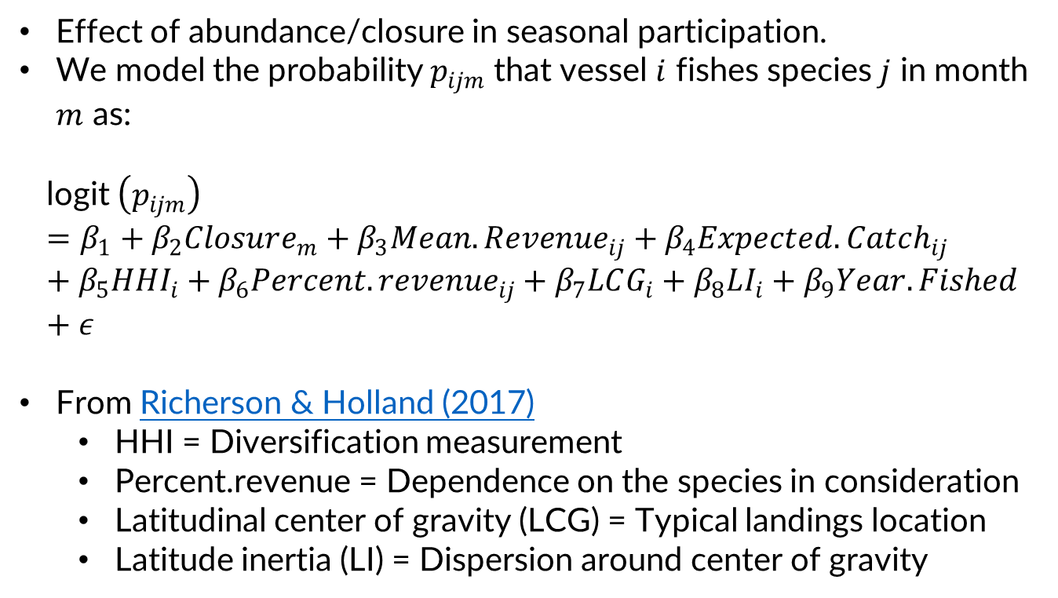
Participation model << No results yet! >>
Effect of abundance/closure in seasonal participation.
We model the probability $p_{ijm}$ that vessel $i$ fishes species $j$ in month $m$ as:
$$\text{l}\text{ogit} \left(p_{ijm}\right)=β_{1}+β_{2}Closure_{m}+β_{3}Mean.Revenue_{ij}+β_{4}Expected.Catch_{ij}+β_{5}HHI_{i}+β_{6}Percent.revenue_{ij}+β_{7}LCG_{i}+β_{8}LI_{i}+β_{9}Year.Fished+ε$$
From Richerson & Holland (2017)
HHI = Diversification measurement
Percent.revenue = Dependence on the species in consideration
Latitudinal center of gravity (LCG) = Typical landings location
Latitude inertia (LI) = Dispersion around center of gravity

